Slide 1
REII323– Embedded Operating systems
STM32’s Internal peripherals
Gerrit Buter
2/09/2025

Slide 2
Internal peripherals Field Guide chapters 4,5,6
Outcomes
PWM
Timers
UART
ADC
https://tinyurl.com/reii323-practical
Class program
Overview
In Depth Guide (follow along)
PWM/Timers ± 1h
UART ±30 min
ADC ±30 min
Class Activity- Merge all 4 topics

Slide 3
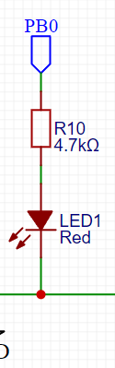
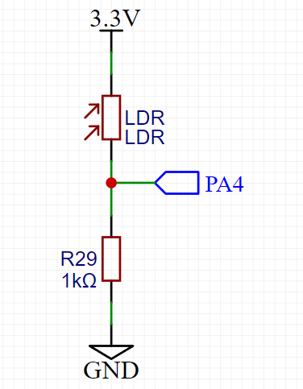
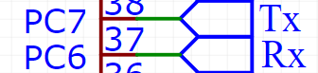
Class Activity:
Setup a PWM signal on LED1 to not see flickering
Sample the LDR at 1kHz
Transmit the Voltage Level over UART
Adapt the Brightness of LED1 based on the LDR’s reading
__HAL_TIM_SET_COMPARE(&htim4, TIM_CHANNEL_4, CurrentPWM);

Slide 4
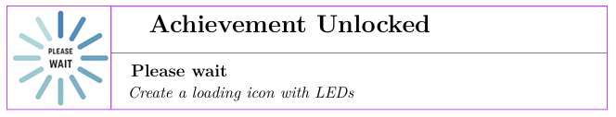
Advanced Activity:
Exercise 4: LED Loading Icon with Tail Effect
Page 356 Field guide

Slide 5
Function Template builder:
Build a Template for all topics in this and the previous class, so in a exam or practical you can just copy your previous code
Specifically have:
Code ready for interrupt functions
Code ready for usage of internal peripherals
ADC
Timers
UART (add sprint)
PWM
Digital I/O

Slide 6
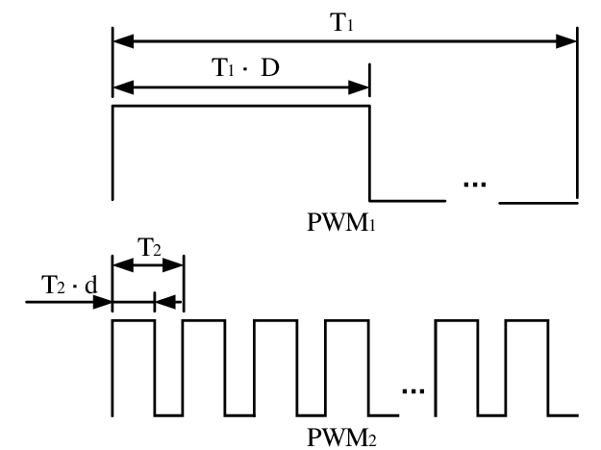
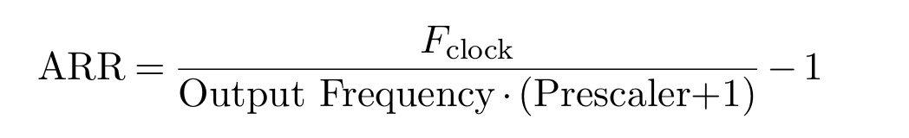
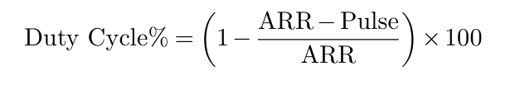
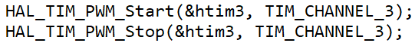
Timer Calculations
Human Visual range: ± 1khz
Human Audible range: ± 20khz
Clock Source = Internal Clock

Slide 7
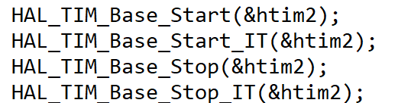
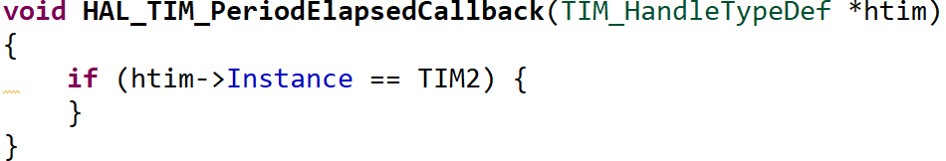
Timers and Interrupts

Slide 8
UART
Must be able to:
Echo transmission
Parse commands
Send Commands
See fieldguide pages 315 – 318
UART Template available on github
Switch headers, download PuTTY / Termite

Slide 9
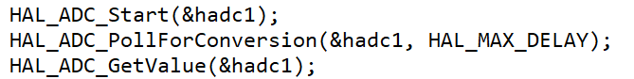
ADC (with LDR example)
You only have 1 ADC, thus you can only sample 1 channel at a time
For now only basic ADC usage is required:
A rolling average is advised but not strictly necessary

Slide 10
Class Activity:
Setup a PWM signal on LED1 to not see flickering
Sample the LDR at 1kHz
Transmit the Voltage Level over UART
Adapt the Brightness of LED1 based on the LDR’s reading
__HAL_TIM_SET_COMPARE(&htim4, TIM_CHANNEL_4, CurrentPWM);

Slide 11
Function Template builder:
Build a Template for all topics in this and the previous class, so in a exam or practical you can just copy your previous code
Specifically have:
Code ready for interrupt functions
Code ready for usage of internal peripherals
ADC
Timers
UART (add sprint)
PWM
Digital I/O

